Slide 1

BUIE SPACE
(An Educational related platform)
Submitted by :
Tapas Pal
University Roll No:10500118001
Suman Mandal
University Roll No: 10500118006
Amit Kabi
University Roll No: 10500118021
Amit Goswami
University Roll No:10500118022
Under the supervision of
Prof. Satya Gopal Chandra
A project report submitted in partial fulfillment for
the degree of Bachelor of Technology in Computer
Science & Engineering
Department Computer Science & Engineering
Bankura Unnayani Institute of Engineering
Bankura - 722146, West Bengal, India
March,2021

Slide 2
Dedicated to my parents

Slide 3
Certificate of Approval
The forgoing project report is hereby approved as a creditable study of Technological subject carried out and presented in a manner satisfactory to warrant its acceptance as a prerequisite with degree for which it has been submitted. It is to be understood that by this approval, the undersigned do not necessarily endorse or approve any statement made, opinion expressed or conclusion drawn there in but approve the thesis only for the purpose for which it has been submitted.
Board of Examiners

Slide 4
Declaration
I hereby declare that this submission is my own work and that, to the best of my knowledge and belief, it contains no material previously published or written by another person nor material which has been accepted for the award of any other degrees or diplomas of the university or other institutes of higher learning,
except which due acknowledgment has been made in this text.
........................................................
Signature

Slide 5
Certificate
This is certified that the work contained in this report entitled, BUIE SPACE, by AMIT KABI, has been carried out under the supervision of the undersign and this work has not been submitted elsewhere for any other degree.
(Signature of the Supervisor)
Mr. Subrata Pan, Assistant Professor, Department of CSE
Bankura Unnayani Institute of Engineering
Bankura, West Bengal
(Signature of the Co-supervisor)
Mr. Satya Gopal Chandra, Assistant Professor, Department of CSE
Bankura Unnayani Institute of Engineering
Bankura, West Bengal
(Signature of the HoD)
Mr. Aloke Roy, Associate Professor, Department of CSE
Bankura Unnayani Institute of Engineering
Bankura, West Bengal

Slide 6
Acknowledgments
I hereby wish to express my sincere gratitude and respect to Assistant Prof. Satya Gopal Chandra, Dept. of CSE, Bankura Unnayani Institute Of Engineering, Bankura under whom I had proud privilege to work. His valuable guidance and encouragement have really led me to the path of completion of this project. Any amount of thanks would not be enough for the valuable guidance of my supervisor. I would also like to thank all the faculty member of CSE dept. for their devoted help. I also cordially thank all laboratory assistants for their cooperation. Finally, I would like to pen down my gratitude towards my family members for their continuous support and encouragement. It would have not been possible to complete my work without their support.

Slide 7
ABSTRACT
Web application intends to provide a well-established web-based Social Network system between a student and a teacher. This documents a networking system scope, functionalities, requirements and feasibility. This project aims to develop a website which provides a Communication among peoples on network, which works quite similar to Social Media Site. This website also provides the features of writing and posting a post or any event all at one place. The main idea behind it is to share the education related details posted by teachers via adding a post which can be read by all the student as well as faculty using the website. This web application can be handled by the admin and manage student as well as faculty.
The following points are implemented in this system: – Students can register and login into the system once their registration is successful. – Once the student logged in into the system, he/she can write and post an articles on various topic of his/her choice. – All students can view News Feed posted by individual student. – Admin Login has full authority on system, he/she can add/delete Faculty. – Teachers can upload class notes, class routine, previous year question paper.

Slide 8
CONTENTS
Introduction 1
Project Descriptions 2
2.1 Project Overview . . . . . . . . . . . . . . . . . . . . . . . . . . . . . 3
2.2 Purpose of the Project . . . . . . . . . . . . . . . . . . . . . . . . . . 3
2.2.1 Background of the Project . . . . . . . . . . . . . . . . . . . . 3
2.2.2 Goals of the Project . . . . . . . . . . . . . . . . . . . . . . . 3
2.3 Scope of the Work . . . . . . . . . . . . . . . . . . . . . . . . . . . . 3
2.4 Product Scenarios . . . . . . . . . . . . . . . . . . . . . . . . . . . . . 3
2.5 Stakeholders . . . . . . . . . . . . . . . . . . . . . . . . . . . . . . . . 3
2.6 Mandate Constraints . . . . . . . . . . . . . . . . . . . . . . . . . . . 3
2.7 Naming Conventions & Definitions . . . . . . . . . . . . . . . . . . . 3
2.7.1 Definition of Key Terms . . . . . . . . . . . . . . . . . . . . . 3
2.7.2 UML & other Notation used . . . . . . . . . . . . . . . . . . . 3
2.7.3 Data Dictionary for any included models . . . . . . . . . . . . 3
2.8 Relevant Facts & Assumptions . . . . . . . . . . . . . . . . . . . . . . 3
3. Requirements 4
3.1 Product Use Cases . . . . . . . . . . . . . . . . . . . . . . . . . . . . 5
3.2 Functional Requirements . . . . . . . . . . . . . . . . . . . . . . . . . 5
3.3 Data Requirements . . . . . . . . . . . . . . . . . . . . . . . . . . . . 5
3.4 Performance Requirements . . . . . . . . . . . . . . . . . . . . . . . . 5
3.5 Dependability Requirements . . . . . . . . . . . . . . . . . . . . . . . 5
3.6 Maintainability & Supportability Requirements. . . . . . . . . . . . 5
3.7 Security Requirements . . . . . . . . . . . . . . . . . . . . . . . . . . 5
3.8 Usability & Humanity Requirements . . . . . . . . . . . . . . . . . . 5
3.9 Look & Feel Requirements . . . . . . . . . . . . . . . . . . . . . . . . 5
3.10 Operational & Environmental Requirements . . . . . . . . . . . . . . 5
3.11 Cultural & Political Requirements . . . . . . . . . . . . . . . . . . . . 5
3.12 Legal Requirements . . . . . . . . . . . . . . . . . . . . . . . . . . . . 5

Slide 9
CONTENTS
Design 6
4.1 System Design . . . . . . . . . . . . . . . . . . . . . . . . . . . . . . . 7
4.1.1 Design Goals . . . . . . . . . . . . . . . . . . . . . . . . . . . 7
Current Software Architecture . . . . . . . . . . . . . . . . . . . . . . 7
Proposed Software Architecture . . . . . . . . . . . . . . . . . . . . . 7
4.3.1 Overview . . . . . . . . . . . . . . . . . . . . . . . . . . . . . 7
4.3.2 Class Diagrams . . . . . . . . . . . . . . . . . . . . . . . . . . 7
4.3.3 Dynamic Model . . . . . . . . . . . . . . . . . . . . . . . . . . 7
Subsystem Decomposition . . . . . . . . . . . . . . . . . . . . 7
Hardware / Software Mapping . . . . . . . . . . . . . . . . . . 7
4.3.6 Data Dictionary . . . . . . . . . . . . . . . . . . . . . . . . . . 7
4.3.7 Persistent Data Management . . . . . . . . . . . . . . . . . . 7
4.3.8 Access Control & Security . . . . . . . . . . . . . . . . . . . . 7
4.3.9 Global Software & Control . . . . . . . . . . . . . . . . . . . . 7
4.3.10 Boundary Conditions . . . . . . . . . . . . . . . . . . . . . . . 7
4.4 Subsystem Services . . . . . . . . . . . . . . . . . . . . . . . . . . . . 7
4.5 User Interface . . . . . . . . . . . . . . . . . . . . . . . . . . . . . . . 7
4.6 Object Design . . . . . . . . . . . . . . . . . . . . . . . . . . . . . . . 7
Test Plans 8
Features to be tested / not tested . . . . . . . . . . . . . . . . . . . . 8
Testing materials ( Hardware / Software Requirements ) . . . . . . . 8
5.3 Test Cases . . . . . . . . . . . . . . . . . . . . . . . . . . . . . . . . . 8
Project Issues 9
6.1 Open Issues . . . . . . . . . . . . . . . . . . . . . . . . . . . . . . . . 9
6.2 Off-the-Shelf Solutions . . . . . . . . . . . . . . . . . . . . . . . . . . 9
6.3 New Problems . . . . . . . . . . . . . . . . . . . . . . . . . . . . . . . 9
6.4 Tasks . . . . . . . . . . . . . . . . . . . . . . . . . . . . . . . . . . . . 9
6.5 Migration to the new product . . . . . . . . . . . . . . . . . . . . . . 9
6.6 Risks . . . . . . . . . . . . . . . . . . . . . . . . . . . . . . . . . . . . 9
Latex Tutorial 10

Slide 10
LIST OF CONTENTS
S. NO. | TITLE | PAGE NO.
 | Candidate’s Declaration | I
 | Acknowledgement | Ii
 | Abstract | Iii
 | List of Figures | Iv
CHAPTER-1 | OBJECTIVE AND SCOPE | 1-2
1.1 | OBJECTIVES | 1
1.2 | SCOPE | 1-2
CHAPTER-2 | THEORETICAL BACKGROUND | 3-4
2.1 | BACKGROUND OF THE SYSTEM | 3
2.2 | TECHNOLOGY USED | 4
CHAPTER-3 | DEFENITIONOF THE PROBLEM | 5-6
3.1 | DEFINITION OF THE PROBLEM | 5
3.2 | DRAWBACK IN EXISTING SYSTEM | 5
3.3 | PROPOSED SYSTEM | 5
3.4 | ADVANTAGES OF PROPOSED SYSTEM | 6
CHAPTER-4 | SYSTEM ANALYSIS & DEGINE VIS-À-VIS USER REQUIREMENTS | 7-10
4.1 | SYSTEM ANALYSIS | 7-8
4.2 | FEASIBILITY STUDY | 8-9
4.3 | FACT FINDING TECHNIQUES | 9-10

Slide 11
LIST OF CONTENTS
S. NO. | TITLE | PAGE NO.
CHAPTER-5 | SYSTEM PLANNING, METHODOLOGY USED AND SOFTWARE HARDWARE REQUIREMENTS | 10-17
5.1 | SOFTWARE LIFE CYCLE | 10-16
5.2 | TECHNOLOGY USED | 16-17
5.3 | TESTING | 17
CHAPTER-6 | DETAILED LIFE CYCLE OF PROJECT | 17- 36
6.1 | ARCHITECTURE DESIGN | 18
6.2 | DATA FLOW DIAGRAM | 19
6.3 | USE CASE DIAGRAM | 19-20
6.4 | DFD’s LEVELS | 20-23
6.5 | GANTT CHARTS | 23
6.6 | INPUT AND OUTPUT DESIGNS | 24-25
6.7 | METHODOLOGY | 26-29
6.8 | TESTING | 29-34
CHAPTER-7 | CODING | 37-46
7.1 | SETTINGS.PY | 37-39
7.2 | VIEW.PY | 39-46
CHAPTER-8 | BIBLIOGRAPHY | 37
8.1 | REFERENCES | 37
8.2 | WEB REFERENCES | 37

Slide 12
LIST OF FIGURES
FIGURE NO. | TITLE | PAGENO.
4.1 | Use Case Diagram for Social Site | 10
5.1 | SDLC process | 11
5.2 | Software development life cycle | 13
5.3 | Steps of project planning | 14
6.1 | WBS | 18
6.2 | Top-Down Approach | 18
6.3 | Data flow diagram | 19
6.4 | Use Case diagram | 20
6.5 | DFD Level Diagram 0 | 21
6.6 | DFD Level Diagram 1 | 21
6.7 | DFD for admin | 22
6.8 | DFD level diagram 2 | 22
6.9 | DFD for user | 23
6.10 | View Result | 23
6.11 | Home page) | 24
6.12 | Admin Panal) | 24
6.13 | Login Page | 25
6.14 | Registration form | 25
6.15 | Main process | 27
6.16 | Admin module | 28
6.17 | User module | 29

Slide 13
CHAPTER 1
OBJECTIVE AND SCOPE OF THE PROJECT
“Build the best product, cause no unnecessary harm, use business to inspire and implement solutions for Social Site”
OBJECTIVES
The main objective of our Project is to Provide a healthy environment where a user can create his/her Profile and get class notes , routine , previous year question paper also student or teacher can post article. Our website will provide a platform where a user can post educational article.
SCOPE
BUIE SPACE is a web based concept which aims to provide the students with the access to a Platform where they can create a educational content and get study material from it. Through this project we try to solve a problem of Indian students ,this is the all in one site where any students can get college notice,routine,classs notes and he/she can post any query on article section. It will be very useful for all students.
Idea of the project and technology finalization
Started from 30/9/2020
Number of days 14
Ended at 14/10/2020
Requirement analysis
Started from 15/10/2020
Number of days 15
Ended at 30/10/2020

Slide 14
1.2.3 Implementation
Task : Design and Coding
Started from 10/11/2020
Completed first prototype on 25/11/2020
Remaining work is continued till date
Testing
Task : Testing and fixing the issues
Started from 01/12/2020
Number of days 30
End at 2/01/2021
The project is made using JavaScript and Django frameworks for both front as well as backend powered with SQLite database.

Slide 15
CHAPTER 2
THEORETICAL BACKGROUND
2.1 Background of the System for which the system is being developed
Our BUIE SPACE site allow students to interact with common interests to meet, communicate and share educational thought through network like the web. While doing this, participants develop bonds with each other and the community as a whole.
We define site as web-based services that allow individuals to
(1) Construct a profile within a bounded environment.
(2) Publish article our web based System.
(3) Get study material free of cost.
The main idea behind it is to share the post that contain images and its description written and posted by users regarding there post without paying any fees to anyone.
This web application can be handled by the admin to manage users and there Post and articles using specialized admin Panel.
Web application intends to provide a well-established web-based Social Network system between students with common interest. This documents a networking system scope, functionalities, requirements and feasibility. This project aims to develop a website which provides a Communication among peoples on network, which works quite similar to Social Media Site. This website also provides the features of writing and posting a post or images all at one place. The main idea behind it is to share study work posted by users via adding a post which can be read by all the users using the website. This web application can be handled by the admin to manage students.

Slide 16
2.2 Technology Used.
To build this website we are using Django as a backend Framework and Bootstrap as front end Framework as these are very strong and highly recommended frameworks in market.
2.2.1 Django Framework.
Django is a web application framework written in Python programming language. It is based on MVT (Model View Template) design pattern. The Django is very demanding due to its rapid development feature. It takes less time to build application after collecting client requirement.
Django was design and developed by Lawrence journal world in 2003 and publicly released under BSD license in July 2005. Currently, DSF (Django Software Foundation) maintains its development and release cycle.
Django was released on 21, July 2005.
Django is widely accepted and used by various well-known sites such as: Instagram, Mozilla, Disqus, Pinterest, Bitbucket.
2.2.2 Bootstrap Framework.
It is an open-source and free CSS framework, which helps in directing a responsive device- friendly mobile-first front-end web page development tool. Bootstrap includes the CSS (Cascading Style Sheets), and an optional JavaScript supported design template (plug-ins) that deals with typography, implementation of buttons, forms, and various other components user interface. This framework helps in faster web development and supports developers in creating responsive web pages faster.
All thanks to Bootstrap developers -Mark Otto and Jacob Thornton of Twitter, though it was later declared to be an open-source project.

Slide 17
CHAPTER 3
DEFINATION OF THE PROBLEM
3.1 Definition of the problem : In this project a platform for common students ,where students can access their class routine ,class notes ,previous year question and as well as they can view college’s important notice .
It will promote a healthy environment by providing a dynamic platform to students without causing any threat to privacy. They’ll be only allowed to view the details which are relevant to them as a user. They’ll be able to view the articles and posts publish by outer users, and the Profile of the user.Users can sign up and login into the system once their registration is done by using registration form.It is very difficult for students to remember class routines,also sometime they don’t came to college and they don’t get class notes so,our site will help those students.They get all types of class notes,previous year question paper and also they can ask query.

Slide 18
3.3 Proposed System:
As the tremendous success that social network services have gained during the past few years, it’s also regarded as the third revolutionary application of the Internet after search engine and Web 2.0 applications. In current scenario the users are tremendously increase over internet, especially emerging services including social networking services.
Although public social network services like Facebook, Twitter, Sina Weibo and RenRen provide good individual and group communication services to their users. For this reason, public social network services have two disadvantages. On one hand, because it cannot be connected with the real environment and activities of student. On the other public social network systems cannot provide strict information and privacy protection to their users and organizations that users are belonged to because of their consideration uncommercial interest.
Social interaction positively influences the quality of the knowledge created on other hand, social network can help users to share there post on relevant topics

Slide 19
Advantages of Proposed System:
Student can access all types of query related to education.
Users will be updated with new thoughts and views.
Student can share as well as obtain knowledge by using this application.
Student can communicate easily with other Student and Admin as well.
This social media platform will become an asset for the community and can be used for various productive purposes.
There will be class related all document.
Previous year question paper will be provided in this platform.

Slide 20
CHAPTER 4
SYSTEM ANALYSIS & DESIGN VIS-À-VIS USER REQUIREMENTS
Various fact finding techniques and analysis tools are used for analysis of the system like On Site Observations, Manual Reading, Review Documents, Interviews and Questionnaire etc.
4.1 System Analysis:
System analysis is the first and foremost step performed in developing the software to solve a particular problem. In the analysis part, a software developer examines the requirements. Carrying out preliminary investigation identifies the requirements. Analysis consists of two sub phases: Planning and Requirement Definition
During planning phase, cost estimates and work schedules will be planned. Requirement definition is a specification that describes the processing environment, the required software functions, performance constrains (size, speed, machine configuration) and exception handling.
4.1.1 Principles of System Analysis:
Understand the problem before you begin to create the analysis model.
Develop prototypes that enable a user to understand how human machine interactions will occur.
Record the origin of and the reason for every requirement.
Use multiple views of requirements like building data, function and behavioral models.
Work to eliminate ambiguity.
System analysis is a separation of a substance into parts for study and their implementation and detailed examination.

Slide 21
4.1.2 Analysis of BUIE SPACE:
Functionality:
User can register and login into the site once they fill the sign up and log in form. Once the user logged in into the site, he/she can write and post an articles on various topic of his/her choice. Also he/she chat with the other users. Users can also upload images with their post. All users can view News Feed posted by individual user. Student can access all types of study material and call related files.
Efficiency:
The main idea behind it is to share the question related details posted by teacher or normal student via adding a post which can be read by all the user as well as admin using the website. This web application can be handled by the admin and manage user as well as faculty.
Accessibility:
Users can register and login into the system once their registration is validated in registration form. Users post are first sent to admin for approval. It keeps the system stable by not posting any spam or miscellaneous content on the web.
4.2 Feasibility study:
The feasibility of the project is analyzed in this phase and business proposal is put forth with a very general plan for the project and some cost estimates. During system analysis the feasibility study of the proposed system is to be carried out. This is to ensure that the proposed system is not a burden to the company. For feasibility analysis, some understanding of the major requirements for the system is essential. Three key considerations involved in the feasibility analysis are: Economical Feasibility, Technical Feasibility, and Social Feasibility.
Economical Feasibility: This study is carried out to check the economic impact that the system will have on the organization. The amount of fund that the company can pour into the research and development of the system is limited. The expenditures must be justified. Thus the developed system as well within the budget and this was achieved because most of the technologies used are freely available. Only the customized products had to be purchased.

Slide 22
Operational Feasibility: Users will get efficient access to information which will help them grow. Faculty Members can use this platform to share concepts which are relevant in the current scenario.
Technical Feasibility: Any system developed must not have a high demand on the available technical resources. The technologies which our System is using are free as django, Bootstrap. Therefore, this Application is Technically Feasible.
Social Feasibility: The aspect of study is to check the level of acceptance of the system by the user. This includes the process of training the user to use the system efficiently. The user must not feel threatened by the system, instead must accept it as a necessity. The level of acceptance by the users solely depends on the methods that are employed to educate the user about the system.

Slide 23
Analysis Through On Site Observations:
For analysis of the system we performed on site observations ie at the time of Class we asked students various questions and observed the working of the system. Some of the questions asked are as follows:
How many student on an average post?
Which post of the student should be added to which category?
How should the site handle the user for the first time?
How the data is managed?
Analysis through Registration
For analysis of the system we took registration of some of the members involved in the site. Some of the questions asked are as follows:
What are the main requirements that you want to see in new site?
What is the purpose of tag form?
How verification process done?

Slide 24
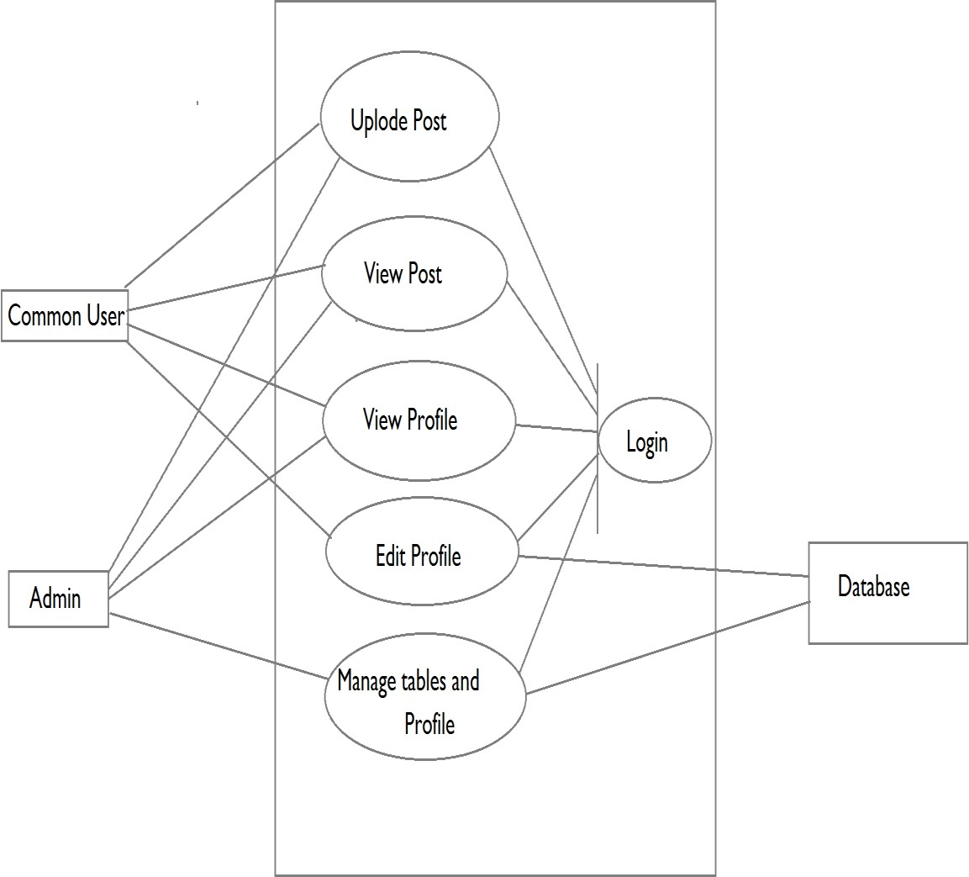
4.3.3 Analysis through Questionnaire:
The analysis of the site was also performed through questionnaires. Some of the questionnaires are as follows:
Can a user have multiple accounts?
Is enquiry form necessary for every user?
What is the role of admin?
Which is the specific period for posting?
What is the minimum requirement for registering?
Fig 4.1 Use Case Diagram for Social Site

Slide 34
Upload Article
View Article
BUIE SPACE)

Slide 35
upload Article
View Article
Article Management
BUIE SPACE
BUIE SPACE

Slide 36
Upload Article
Edit article
BUIE SPACE

Slide 37
Articles
Second level DFD - BUIE SPACE

Slide 38
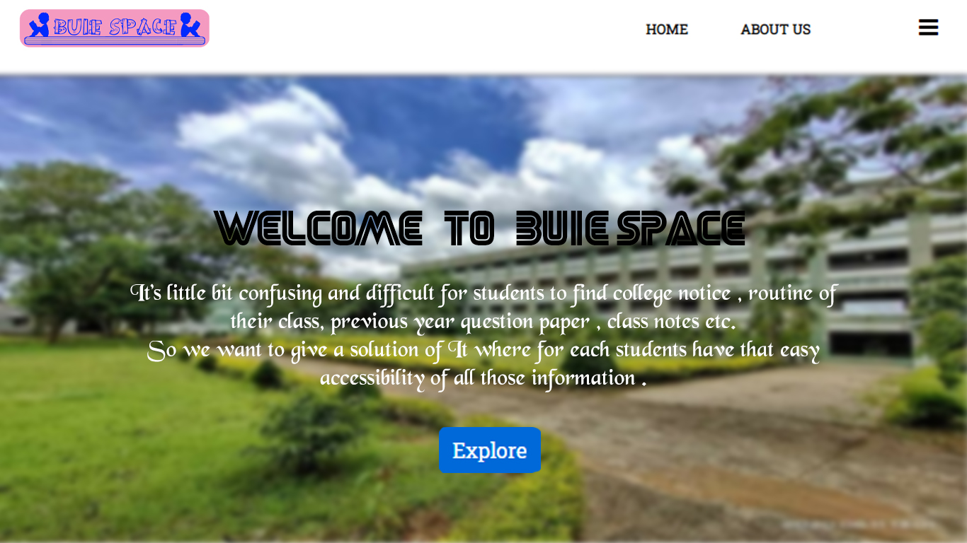
Input and Output Designs
Fig 6.11 (Home page)

Slide 39
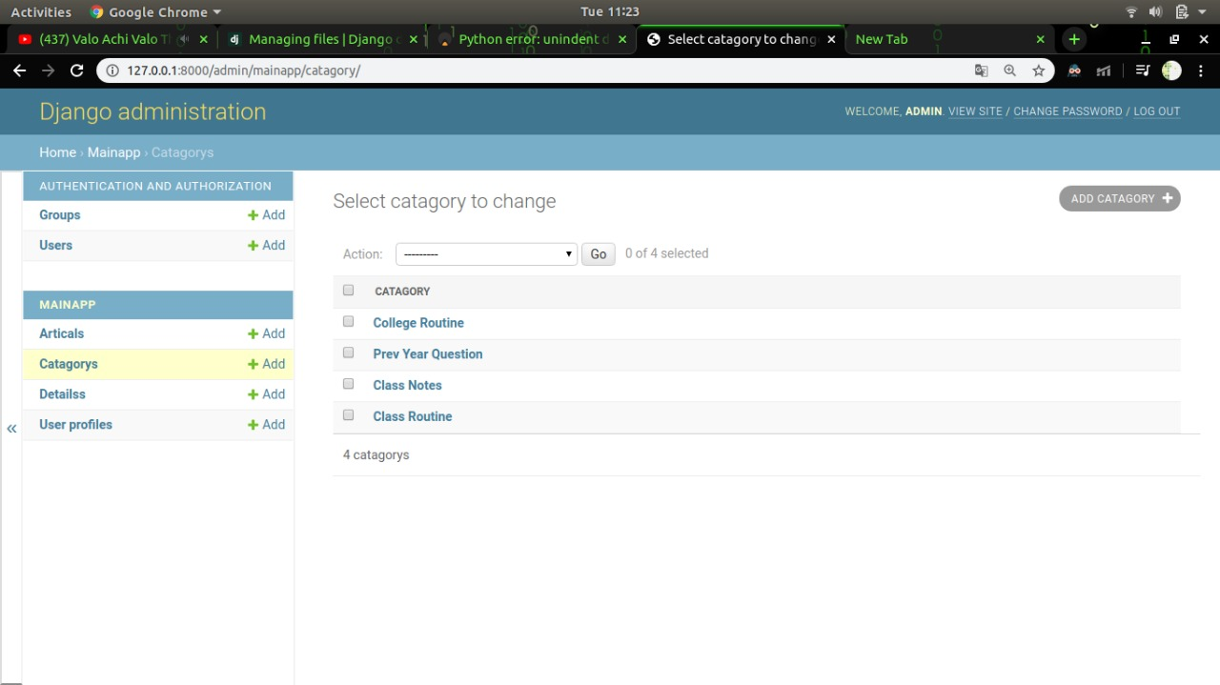
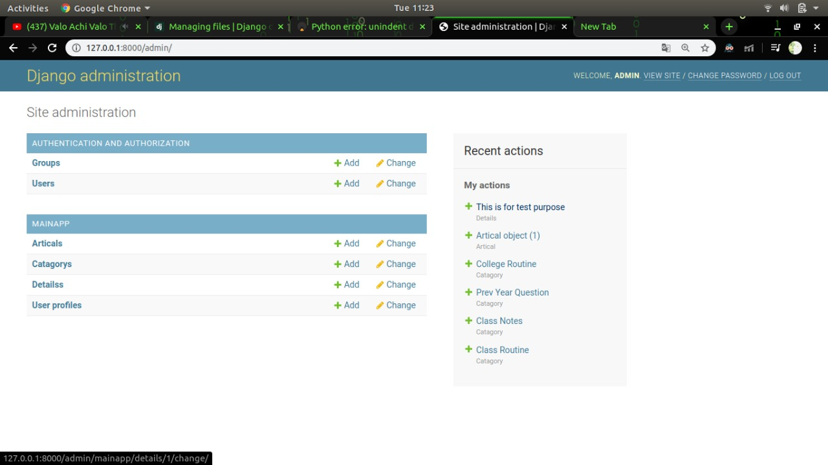
Fig 6.12 (Admin Panal)

Slide 40
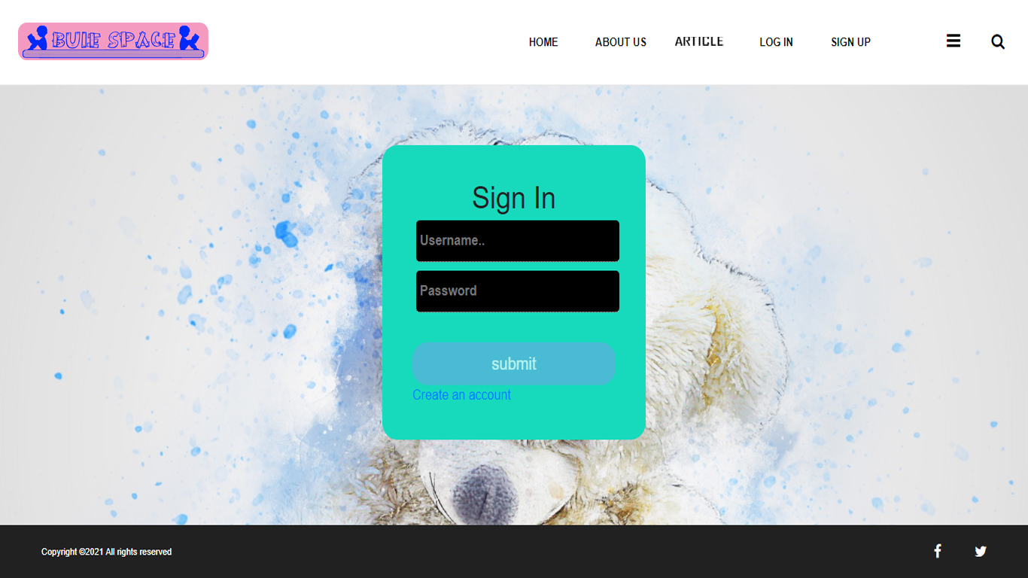

Slide 41
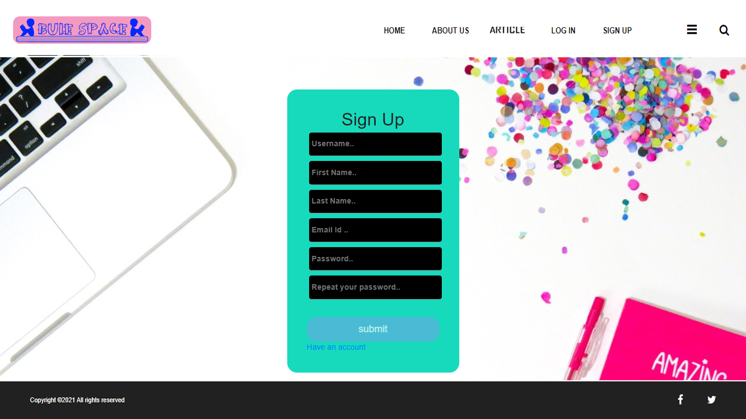
Fig 6.14 (Registration form)

Slide 42
6.1 METHODOLOGY
6.7.1 Diagrammatic process of BUIE SPACE
A software development methodology is a framework that is used to structure, plan, and control the process of developing an information system, this includes the pre-definition of specific deliverables and artefacts that are created and completed by a project team to develop or maintain an application. A wide variety of such frameworks have evolved over the years, each with its own recognized strengths and weakness. Each of the available methodology frameworks are best suited to specific kinds of projects, based on various technical, organizational, project and team considerations. The methodology framework is often defined in some kind of formal documentation. To implement the project goals, the following Methodologies need to be followed:
Specifying the application and various components of the Architecture.
Specifying the bindings between the tasks and the resources either manually or by the design tools.
Specifying the post interconnections between the resources.
Main process of BUIE SPACE
Figure 6.9.1 is the main process diagram of this project. In this diagram admin and users play main role. Admin register and keep check on all users.

Slide 43
Upload Article
View Article

Slide 44
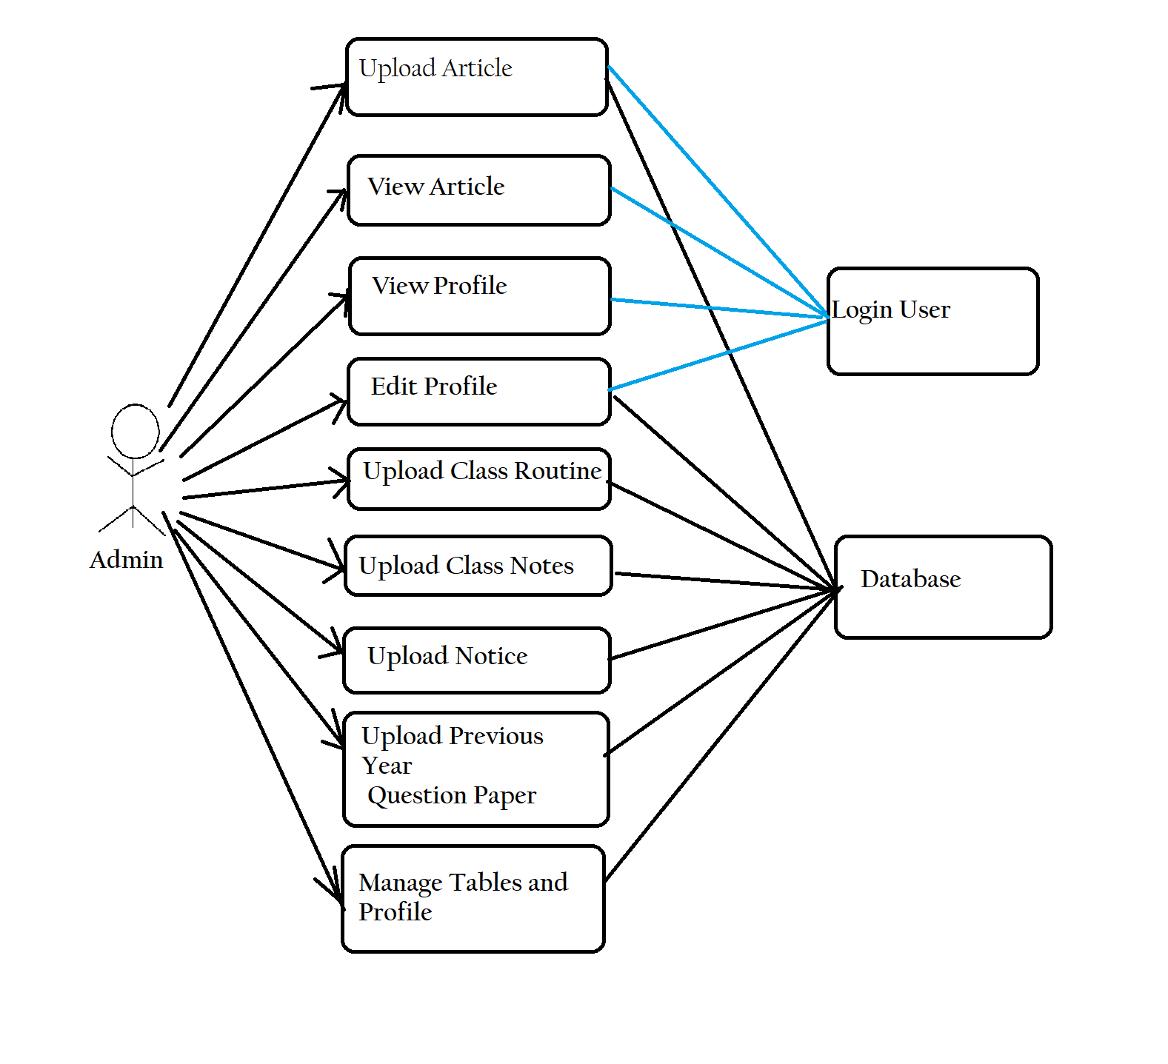

Slide 45
Upload article
View article

